Slide 1
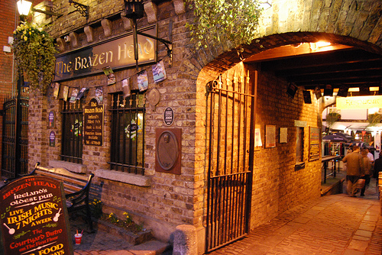

Slide 2
What’s with this DNS thing?
Terry Manderson

Slide 3
Outline
Overview of the Domain Name System
Explanation of Anycast
Root Server System and Root Server Operators
The Governance of the Root Server System

Slide 4
Overview of the Domain Name System

Slide 5
Identifiers on the Internet
IP
Addresses
Notes:
This is what the ASO is responsible for.
The fundamental identifier on the Internet is an IP address.
Each host (or sometimes group of hosts) connected to the Internet has a unique IP address.
IPv4 or IPv6 (192.0.2.1, 2001:db8::1)
Uniqueness guaranteed through allocation from a single pool (IANA-RIR system) and careful management within a network.
60

Slide 6
Identifiers on the Internet
The Fundamental Identifier on the Internet
IP
Addresses
Notes:
This is what the ASO is responsible for.
The fundamental identifier on the Internet is an IP address.
Each host (or sometimes group of hosts) connected to the Internet has a unique IP address.
IPv4 or IPv6 (192.0.2.1, 2001:db8::1)
Uniqueness guaranteed through allocation from a single pool (IANA-RIR system) and careful management within a network.
60

Slide 7
Identifiers on the Internet
The Fundamental Identifier on the Internet
All Hosts Connected to the Internet have IP Addresses
IP
Addresses
Notes:
This is what the ASO is responsible for.
The fundamental identifier on the Internet is an IP address.
Each host (or sometimes group of hosts) connected to the Internet has a unique IP address.
IPv4 or IPv6 (192.0.2.1, 2001:db8::1)
Uniqueness guaranteed through allocation from a single pool (IANA-RIR system) and careful management within a network.
60

Slide 8
Identifiers on the Internet
The Fundamental Identifier on the Internet
All Hosts Connected to the Internet have IP Addresses
IP
Addresses
IPv4 or IPv6
192.0.2.1
2001:db8::1
Notes:
This is what the ASO is responsible for.
The fundamental identifier on the Internet is an IP address.
Each host (or sometimes group of hosts) connected to the Internet has a unique IP address.
IPv4 or IPv6 (192.0.2.1, 2001:db8::1)
Uniqueness guaranteed through allocation from a single pool (IANA-RIR system) and careful management within a network.
60

Slide 9
Identifiers on the Internet
The Fundamental Identifier on the Internet
All Hosts Connected to the Internet have IP Addresses
IP
Addresses
A Numerical Label
IPv4 or IPv6
192.0.2.1
2001:db8::1
Notes:
This is what the ASO is responsible for.
The fundamental identifier on the Internet is an IP address.
Each host (or sometimes group of hosts) connected to the Internet has a unique IP address.
IPv4 or IPv6 (192.0.2.1, 2001:db8::1)
Uniqueness guaranteed through allocation from a single pool (IANA-RIR system) and careful management within a network.
60

Slide 10
Why DNS?
Original Problem
IP addresses are hard to remember.
IP addresses often change.
Modern Problem
IP addresses may also be shared.
Multiple IP addresses may serve as entry points to a single service. Which IP address to use?
Notes:
IP Addresses are not meant to be human memorable
It used to be a one-to-one mapping of IP address to machine on Internet. Now things are much more complicated.
IP addresses can be shared behind NAT and CGNAT, and there is also Anycast which we will talk about later.
60

Slide 11
The Domain Name System
A look up mechanism for translating objects into other objects
Root
Top Level
uk
2nd Level
co
Top Level
edu
2nd Level
cmu
3rd Level
bbc
Top Level
org
2nd Level
example
2nd Level
icann
3rd Level
www
name-to-IP Address
www.example.org 198.51.100.52
Many Other Mappings
Mail Servers
IPv6
Reverse
A globally distributed, loosely coherent, scalable, dynamic database
Notes:
This slide is about the structure of the data in DNS.
The DNS is a hierarchical system with the root zone at the top. TLDs immediately beneath that, and then second level domains and further beneath that.
There can be only one root zone, because there can only be one root of the hierarchy.
DNS records allow the translation of names into IP addresses and other objects that are necessary for services like email to work.
60

Slide 12

The Domain Name System
Notes:
60

Slide 13
The Domain Name System
You will need: Paper, Pens, People, Enthusiasm Paper: Top half Query Bottom half Response (AKA DNS Messages) You will need 4 of these sheets
Notes:
60

Slide 14
The Domain Name System
You will need: Each person has a role: Stub resolver Recursive resolver (empty cache) Root Name Server TLD Name Server Authoritative Domain Name Server Roles Info Sheets and logging
Notes:
60

Slide 15
The Domain Name System
Your mission: Simulate, with people, paper, and pens the process for how a fully qualified domain name (FQDN) is resolved to an IP address The FQDN is one of: www.brazenhead.com. www.brazenhead.ie. A single piece of paper is your DNS exchange, Query and Response
Notes:
60

Slide 16
The Domain Name System
Your mission: Write your Query as: Name: <domain name> Type: A Class: IN Write your Response as: Name: <domain name> Type: A Class: IN Answer Section: <WHAT YOU KNOW>
Notes:
60

Slide 17
The Domain Name System
Root, TLD, Authoritative: When you process a query, keep a log for the opportunity to win beer!! The first Stub back with a correct answer wins beer tickets for the people who participated in their DNS Resolution.
Notes:
60

Slide 18
The Domain Name System
Stub to Recursive Resolver Query Name: WWW.BRAZENHEAD.COM Type: A Class: IN
Notes:
60

Slide 19
The Domain Name System
Recursive Resolver to Root Server Query Name: WWW.BRAZENHEAD.COM Type: A Class: IN
Notes:
60

Slide 20
The Domain Name System
Root Server back to Recursive Resolver Response Name: Type: A Class: IN Answer Section:
Notes:
60

Slide 21
The Domain Name System
Recursive Resolver to TLD Server Query Name: Type: A Class: IN
Notes:
60

Slide 22
The Domain Name System
TLD Server back to Recursive Resolver Response Name: Type: A Class: IN Answer Section:
Notes:
60

Slide 23
The Domain Name System
Recursive Resolver to Authoritative Domain Server Query Name: Type: A Class: IN
Notes:
60

Slide 24
The Domain Name System
Authoritative Domain Server back to Recursive Resolver Response Name: Type: A Class: IN Answer Section:
Notes:
60

Slide 25
The Domain Name System
Recursive Resolver back to Stub Response Name: Type: A Class: IN Answer Section:
Notes:
60

Slide 26
The Domain Name System
Root, TLD, Authoritative: When you process a query, keep a log for the opportunity to win beer!! The first Stub back with a correct answer wins beer tickets for the people who participated in their DNS Resolution. Stubs… 1/2 WWW.BRAZENHEAD.COM 1/2 WWW.BRAZENHEAD.IE
Notes:
60

Slide 27

The Domain Name System
Clarifying questions?
This Photo by Unknown Author is licensed under CC BY-NC
Notes:
60

Slide 28

The Domain Name System
This Photo by Unknown Author is licensed under CC BY-SA
Notes:
60

Slide 29
The Domain Name System
Part 2
consider the exercise with www.pornhub.com
What happens if the person who plays the “Recursive Resolver” will immediately return “NXDOMAIN” as the Answer.
Notes:
60

Slide 30
The Domain Name System
Part 2
What is the actual address of www.pornhub.com.???
Notes:
60

Slide 31
The Domain Name System
Part 2
What is the actual address of www.pornhub.com.???
The actual A record for Pornhub’s website is:
66.254.114.41
Notes:
60

Slide 32
The Domain Name System
Part 2
What is the actual address of www.pornhub.com.???
What role did any of the other participants play??
Why did this happen?
What are the implications of security? Privacy? Intent?
Who owns the network? What are their rules?
Uni, Corporate, Home (kids in the house?), Coffee Shop.
Where are the best vantage points for surveillance?
Notes:
60

Slide 33
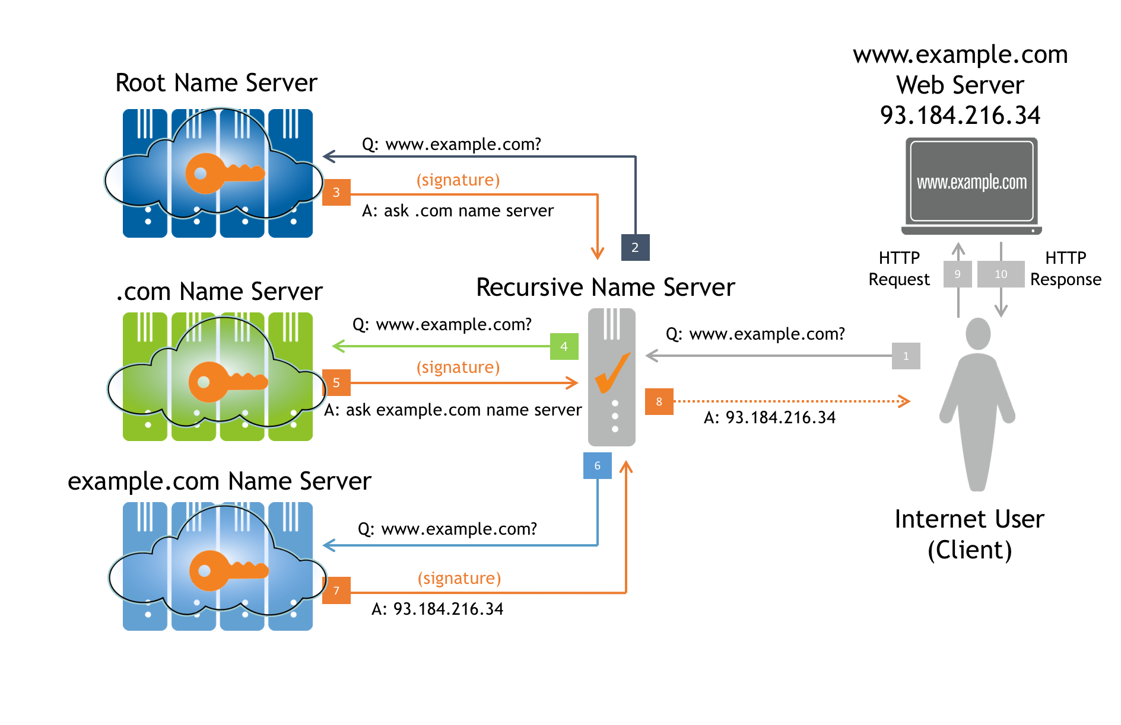
Domain Name Resolution Process
Root Servers are at the entry point to the hierarchical system.
Caching is used throughout to avoid repetitive queries.
The DNS resolution precedes the actual transaction the users want to do (web, mail, voip call, etc.).
Notes:
Tie everything together that we just talked about.
Reading from right to left, a user first makes a query to their configured recursive server for www.example.com.
If the recursive has an entry in its cache for any one of those 3 labels it will start there. If it doesn’t know where the .com nameservers are located it must ask a root server. Next it will ask the .com nameserver where the example.com nameserver is, and then it will ask the example.com nameserver the IP address of www.example.com.
60

Slide 34


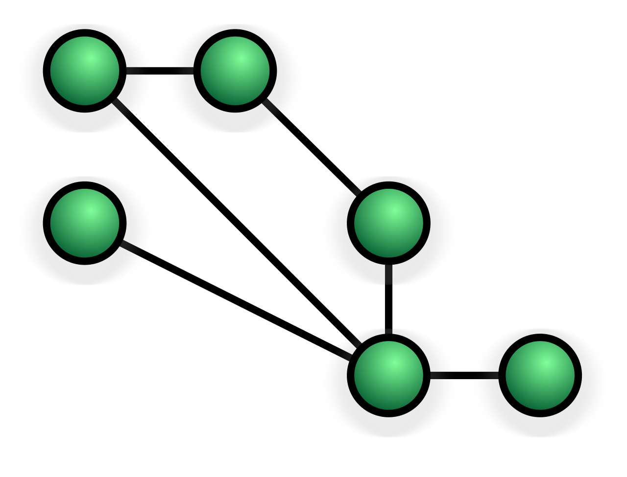
Some Modern Refinements to DNS
DNSSEC (security extensions) | Cryptographic signatures on DNS data Reduces risk of “spoofing” Resolver should validate the answers
Privacy Enhancements | Queries can leak information Standards work is ongoing to address this DNS-over-TLS (DoT)
Anycast | Multiple servers share a single IP address Improves latency and resilience Protects against DDoS attacks
Notes:
DNSSEC is a technology for cryptographically signing DNS records. This allows recursive DNS servers to validate the responses they get and can prevent the spoofing of DNS records.
The IETF is currently working on some privacy enhancements for DNS in the DPRIVE WG. These include QNAME Minimization, which limits the number of labels sent in queries. So a recursive server will only send .com to a root server as opposed to sending www.example.com. QNAME minimization is starting to see initial deployments.
A 2nd technology is DNS-over-TLS which aims to encrypt the connection between a user and their recursive server. DNS-over-TLS is currently still under development at the IETF.
Anycast is a technology that allows multiple DNS servers to answer for a single IP address.
60

Slide 35
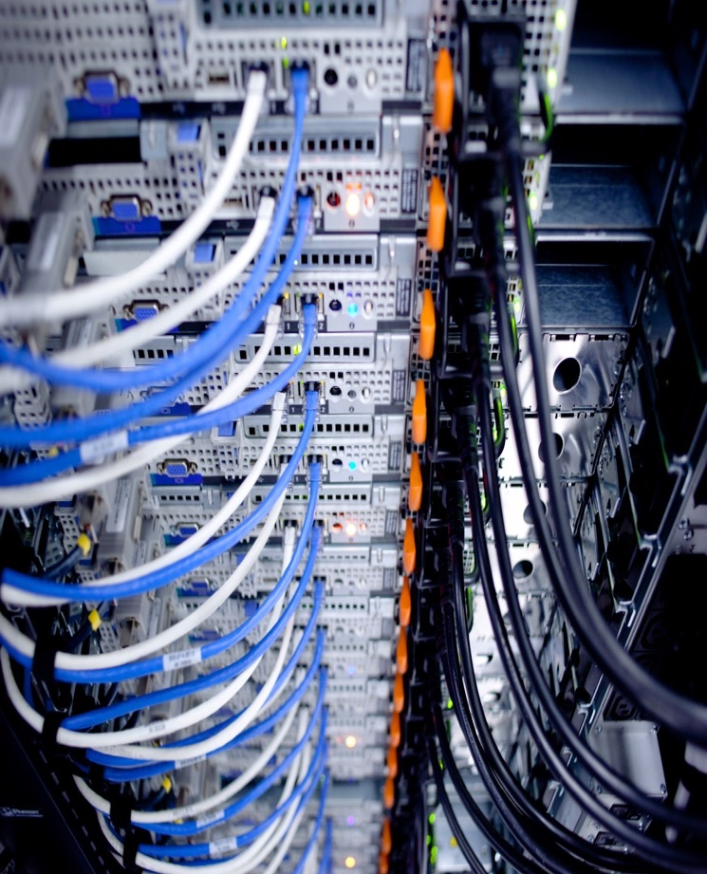
Domain Name System
Root servers only know what servers need to be asked next.
.com
list of .com servers
.net
list of .net servers
.org
list of .org servers
Caching of previous answers means there is less need to query the root servers after the first question.
Notes:
The root servers only know the IP addresses of their immediate child zones, the TLDs. Because recursive DNS servers maintain caches of previous queries many of them don’t have to query root servers that often. The vast majority of queries made to recursive DNS servers do not require a query be made to the root servers.
60

Slide 36
Root Zone vs. Root Server System
Root Zone The starting point: the list of TLDs and their nameservers Managed by ICANN, per community policy Compiled & distributed by the Root Zone Maintainer to all root server operators The database content in the root servers | Root Server System Responds with data from the root zone Currently distributed with 13 identities from over 1000 instances at physical locations worldwide Purely technical role to serve the root zone Responsibility of the root server operators
Notes:
The root zone is the data.
The root servers are the publishers of the data.
60

Slide 37
Definitions
Root Server System (RSS)
The set of root servers that collectively implements the root service.
Root Zone
The DNS zone at the top of the DNS hierarchy. It has no parent and contains all the information necessary to contact the TLDs under it.
Root Server Anycast Instance
One network location responding to DNS queries on a root server operator’s IP address.
Notes:
Definitions of commonly misunderstood terms.
Taken from RSSAC026: RSSAC Lexicon
60

Slide 38
Definitions (roles)
Root Zone Administrator (RZA)
Organization responsible for managing the data contained within the root zone, which involves assigning the operators of top-level domains and maintaining their technical and administrative details.
Root Zone Maintainer (RZM)
Organization responsible for accepting service data from the Root Zone Administrator, formatting it into zone file format, cryptographically signing it, and distributing it to the Root Server Operators.
Root Server Operator (RSO)
An organization responsible for managing the root service on IP addresses specified in the root zone and the root hints file.
Notes:
Definitions of commonly misunderstood terms.
Taken from RSSAC026: RSSAC Lexicon
60

Slide 39
Explanation of Anycast

Slide 40
Unicast vs. Anycast
Unicast
Packets from sources all go to the same destination
A single instance serves all sources
DDoS attack traffic all goes to single instance
Anycast
Multiple instances serve the same data to all sources
Sources reach destination based on intermediate routing policies
Sources get the data faster
DDoS attack traffic is sent to the closest instance
Notes:
Unicast
Packets from sources all go to the same destination
A single instance serves all sources
DDOS attack traffic all goes to single instance
Anycast
Sources use destination based on intermediate routing policies
Multiple instances serve the same data to all sources
Sources get the data faster
DDOS attack traffic is sent to the closest instance
Frees other instances to service genuine traffic
Distributes the overall impact of the attack
60

Slide 41
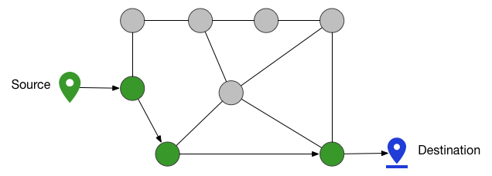
Unicast
Traffic takes shortest route to single destination.
Notes:
As I mentioned before in Unicast, when you send out a packet and it’s going to a destination, it has to follow from the source all the way to that destination. It might take a different path. There could be multiple paths to get there, but it’s always ending up at the same place.
60

Slide 42
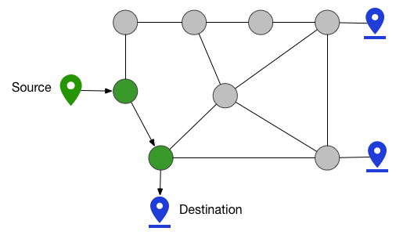
Anycast
Traffic takes shortest route to closest destination.
Intermediate routing policies determine the destination for a source.
Path is shortened and data is delivered more quickly.
Notes:
With Anycast, however, traffic takes the shortest route to the closest destination. So what’s actually happening is that each of these blue dots here would actually be advertising the same address. They’re all saying, “I’m serving this address. If you have traffic that’s close to me, send it my way and I’ll deal with it.” The advantage of that is that the sources are often much closer to the destination, so the responses come quite a bit quicker. So the path is shortened and the data is delivered more quickly
60

Slide 43
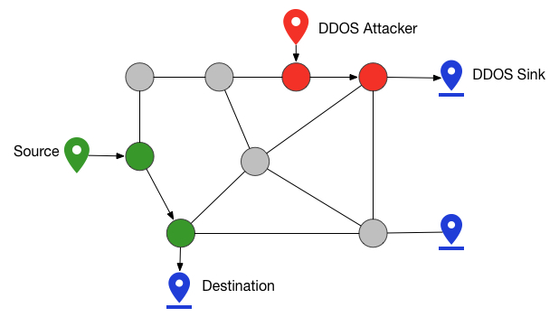
Anycast Under DDoS Attacks
DDoS attack traffic also takes shortest route to closest destination, thus gets distributed across all destinations.
Notes:
The other thing that happens is that under a DDoS attack, where an attacker might be trying to attack an address and overwhelm it, all of that traffic is also going to go the closest instance near that attacker, and it doesn’t affect, say, the rest of the Internet, where all of their traffic is going to their nearby destinations that aren’t overwhelmed by the attack traffic.
60

Slide 44
Root Server System and Root Server Operators

Slide 45
Growth of the Root Server System
1983-1986:
4 Addresses
1987:
7 Addresses
1993:
9 Addresses
1991:
8 Addresses
Changes Over Time
Responding to technical demands
Scaling issues are now solved using anycast
Root Server System Addressing Today
IPv6 addresses added starting in 2008
13 IPv4 and IPv6 Address Pairs
Served from 1000+ International Instances
1998:
13 Addresses
Notes:
The number of root server identities has grown over time as the Internet grew. Now Anycast solves the most pressing scaling problems and handles DDOS as well.
60

Slide 46
Root Server Identifiers Today - 2019
Hostname | IP Addresses | Manager
a.root-servers.net | 198.41.0.4, 2001:503:ba3e::2:30 | VeriSign, Inc.
b.root-servers.net | 199.9.14.201, 2001:500:200::b | University of Southern California (ISI)
c.root-servers.net | 192.33.4.12, 2001:500:2::c | Cogent Communications
d.root-servers.net | 199.7.91.13, 2001:500:2d::d | University of Maryland
e.root-servers.net | 192.203.230.10, 2001:500:a8::e | NASA (Ames Research Center)
f.root-servers.net | 192.5.5.241, 2001:500:2f::f | Internet Systems Consortium, Inc.
g.root-servers.net | 192.112.36.4, 2001:500:12::d0d | US Department of Defence (NIC)
h.root-servers.net | 198.97.190.53, 2001:500:1::53 | US Army (Research Lab)
i.root-servers.net | 192.36.148.17, 2001:7fe::53 | Netnod
j.root-servers.net | 192.58.128.30, 2001:503:c27::2:30 | VeriSign, Inc.
k.root-servers.net | 193.0.14.129, 2001:7fd::1 | RIPE NCC
l.root-servers.net | 199.7.83.42, 2001:500:9f::42 | ICANN
m.root-servers.net | 202.12.27.33, 2001:dc3::35 | WIDE Project
Notes:
All identities have both IPv4 and IPv6 addresses.
60

Slide 47
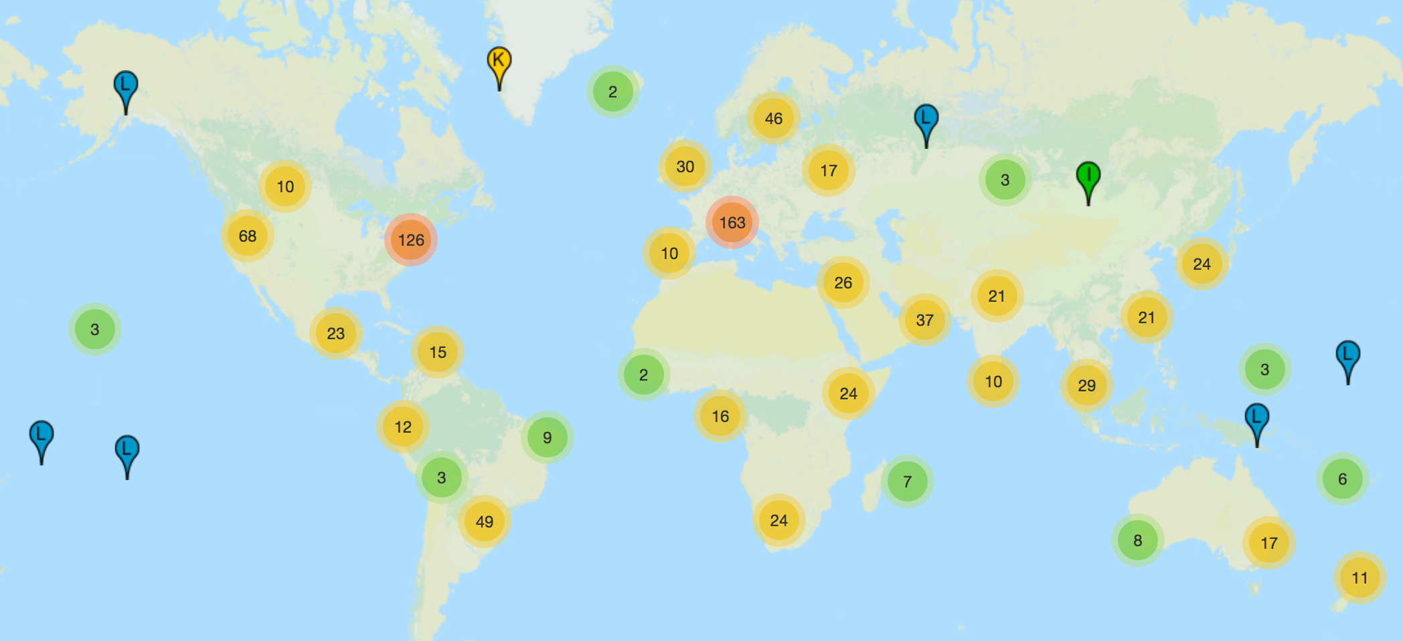
Root Servers Today - 2019
Over 1000 instances around the world – http://root-servers.org/
Notes:
There are currently over 1000 instances of root servers hosted around the world. At time of slides creation, 1,016.
Most information can be found at root-servers.org.
This is taken from root-servers.org and uses generic mapping software so it is not precisely accurate.
60

Slide 48
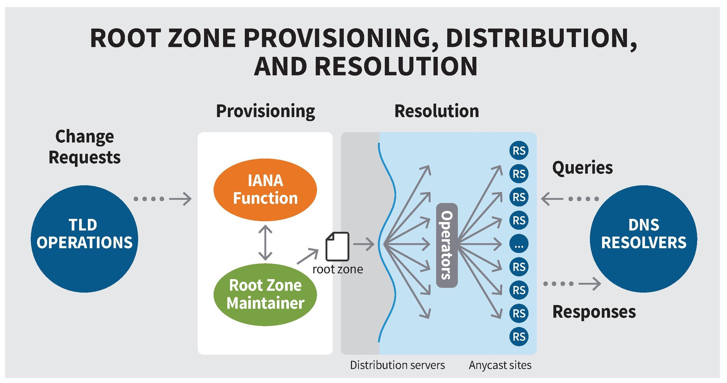
Root Zone Management and Resolution
Notes:
The split in the middle is between the editor and the publisher, provisioning and resolution. The RSOs are only the publishers of the root zone. They are not its editors.
Each root identity hosts multiple anycast instances. These anycast instances provide identical responses
60

Slide 49
Principles of the Root Server System
To remain a global network, the Internet requires a globally unique public namespace.
IANA is the source of DNS root data.
The RSS must be a stable, reliable, and resilient platform for the DNS service to all users.
Diversity of the root server operations is a strength of the overall system.
Architectural changes should result from technical evolution and demonstrated technical need.
The IETF defines technical operation of the DNS protocol.
RSOs must operate with integrity and an ethos demonstrating a commitment to the common good of the Internet.
RSOs must be transparent.
RSOs must collaborate and engage with their stakeholder community.
RSOs must be autonomous and independent.
RSOs must be neutral and impartial
Notes:
Principles of the RSS from RSSAC037
60

Slide 50
Root Server Operators
Twelve different professional engineering groups focused on
Reliability and stability of the service
Accessibility for all Internet users
Technical cooperation
Professionalism
Diverse organizations and operations
Technically
Organizationally
Geographically
Funding Models
Notes:
Root Server Operators are a diverse group of organizations.
This diversity insures better outcomes for stability and resilience.
60

Slide 51
Features of the Root Server Operators
Root Server Operators cooperate
and coordinate through
Industry Meetings and Internet Bodies
RSSAC/ICANN, IETF, RIPE, NANOG, DNS-OARC, APNIC, ARIN, AFNOG
Communication tools
Phone bridges, mailing lists, exchanging secure credentials
Sharing data
Periodic Activities to Support Emergency Response Capabilities
Notes:
Root Service operators cooperate and coordinate to insure a continuity of service.
60

Slide 52
Root Server Operators
Operators ARE involved with
Careful operational evolution of service
Evaluating and deploying suggested technical modifications
Making every effort to ensure stability, robustness and reachability
Operators ARE NOT involved with
Policy making
Data modification -- Operators are publishers, not authors or editors
Notes:
Root Server Operators are a diverse group of organizations.
This diversity insures better outcomes for stability and resilience.
<number>

Slide 53
Myths Corrected
Myth | Reality
Root servers control where Internet traffic goes. | Routers control where Internet traffic goes.
Most DNS queries ARE handled by a root server. | Most DNS queries are NOT handled by a root server.
Administration of the root zone and service provision are the same thing. | Administration of the root zone is separate from service provision.
The root server identities have special meaning. | None of the root server identities are special.
There are only 13 root servers. | There are more then 1000 servers globally, but only 13 technical identities.
The root server operators conduct operations independently. | The collective root server operators coordinate root service operation as a whole.
Root server operators only receive the TLD portion of a query. | Root server operators usually receive the entire query.
Notes:
Root servers do not control where Internet traffic goes, routers do
Most DNS queries are not handled by a root server
Administration of the root zone is separate from service provision
None of the root server letters are special
Root server operators are not hobbyists
More than 13 servers. Only 13 technical identities
The collective root server operators coordinate
The last line “usually” refers to QNAME Minimization (RFC 7816)
<number>

Slide 54
What Does Good Look Like?
Want 3-4 nearby instances
Increasing peering connections
Turn on DNSSEC validation in resolvers
Ensures you are getting unmodified Root Zone (IANA) data
R U Technical? Participate in and contribute to the RSSAC Caucus?
Where technical advice is created
Interested in hosting an Anycast instance?
Talk to an Root Server Operator
Notes:
Let’s talk about the root server system and what you can do on your networks. How can you best optimize it for your local network? First off, you want three to four nearby instances. You want to increase your peering activities and you want to possibly host a root server instance so that you actually are getting the benefit of the slides that I just talked about, where by having one near you and by hosting one near you, you can get that data.
As I mentioned earlier, if you can convince your local resolvers to turn on DNSSEC validation, then you’ll know that nobody on the planet has altered that data since IANA originally wrote it.
And then, also, you can participate and contribute to the RSSAC Caucus, which is where all the technical decisions are made about the root server system and advice is crafted to be sent to ICANN members that have asked for it. We’ll get into the Caucus in a little bit.
<number>

Slide 55
RSSAC and Evolution of the Governance for the Root Server System
(The short version)

Slide 56
A Few Acronyms
RSS
Root Server System
RS
Root Server
RSO
Root Server Operator
SAPF
Strategy, Architecture, and Policy Function
DRF
Designation and Removal Function
PMMF
Performance Monitoring and Measurement Function
FF
SF
Secretariat Function
Financial Function

Slide 57
Setting the Context and Expectations
3-year Effort
New work with RSSAC focus only
An initial draft model
RSSAC is providing a starting point

Slide 58
Thinking Back …
1983-1986:
4 Addresses
1987:
7 Addresses
1993:
9 Addresses
1991:
8 Addresses
Changes Over Time
Responding to technical demands
Scaling issues are now solved using anycast
Root Server System Addressing Today
IPv6 addresses added starting in 2008
13 IPv4 and IPv6 Address Pairs
Served from 1000+ International Instances
1998:
13 Addresses
Notes:
The number of root server identities has grown over time as the Internet grew. Now Anycast solves the most pressing scaling problems and handles DDOS as well.
<number>

Slide 59
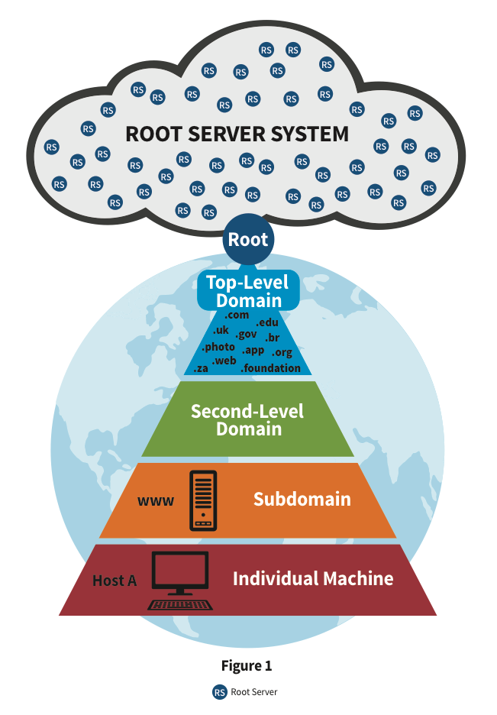
Global DNS Root Services
1000+ DNS root server instances in the global DNS root cloud
Cogent Communications
ICANN
Internet Systems Consortium
NASA Ames Research Center
Netnod
Réseaux IP Européens Network Coordination Centre
University of Maryland
University of Southern California, Information Sciences Institute
U.S. Department of Defense Network Information Center
U.S. Army Research Laboratory
Verisign, Inc.
WIDE Project and Japan Registry Services

Slide 60
Organic. Trusted.
John Postel asked, people rallied.
No-one got paid.
They did a good job.
Earned the trust of, well, everyone who had clue.
…. But time marches on, and the world changed
Notes:
<number>

Slide 61
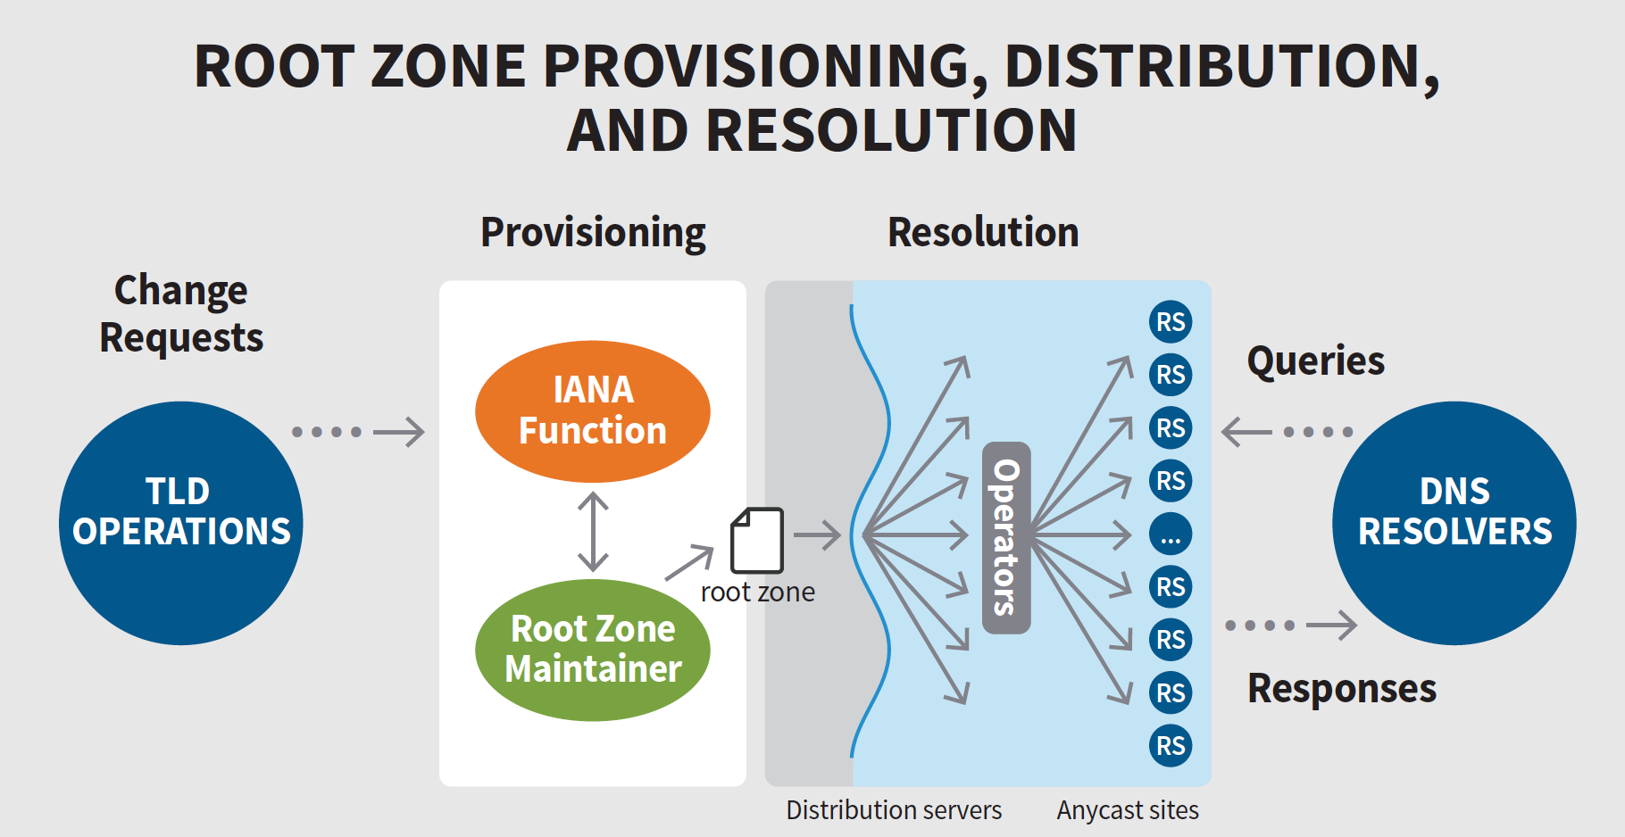
Scope of the Proposed Model

Slide 62
Model Design Principle
Separation of Functions
Avoidance of Conflicts of Interest
Transparency and Auditability
The Model

Slide 63
Stakeholders
RSS
ICANN Community
RSOs
IETF/IAB

Slide 64
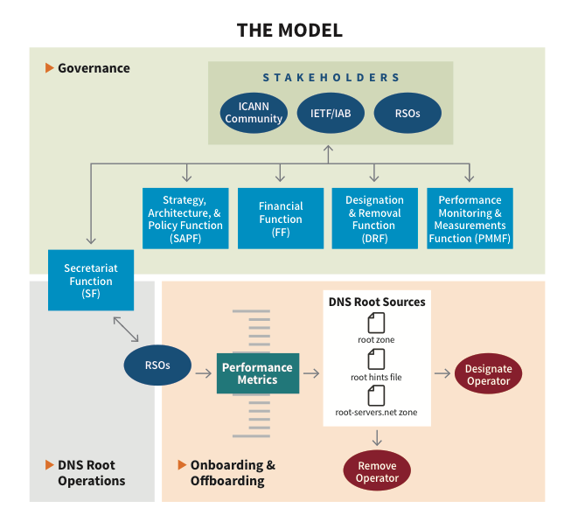
Governance: An interplay of three constructs operating in tandem

Slide 65
Governance: A balance of interplay of separate functions
Governance
SAPF
SF
FF
PMMF
DRF

Slide 66
Secretariat Function (SF)
Secretariat Function (SF)
Perform secretariat functions to coordinate and support RSO operational meetings.
Hold common RSO assets.
A conduit for the Internet community to interact with RSOs.
Other…

Slide 67
Strategy Architecture and Policy Function (SAPF)
Strategy
Coordinating with other stakeholders a strategic vision for the RSS. Examples of such groups include the ICANN Board, IETF/IAB, SSAC, and RZERC.
Strategizing about how to incorporate emerging technologies and how to sunset those technologies that are becoming obsolete.
Architecture
Ensuring that the guiding principles of the RSS and RSOs remain embedded in technical and operational architectures.
Defining system-wide, externally verifiable metrics to demonstrate that the RSS as a whole is online.
Policy
Operationalizing the minimum levels of performance developed in the SAPF architecture stream, and communicating this information to the PMMF.
Articulating policy on handling any grievances concerning an RSO or the RSS.
…and many other responsibilities.
…and many other responsibilities.
…and many other responsibilities.

Slide 68
Designation and Removal Function (DRF)
Designations
Removals
Set of Operators

Slide 69
Performance Monitoring and Measurements Function (PMMF) A sample of what could be measured and monitored
RSO Technical Metrics
System Capacity
Bandwidth
Queries processed
Non-technical Parameters
Ethos
Financials
RSS Metrics
Overall Health of the RSS

Slide 70
Financial Function (FF)
The option to receive funding should exist coupled with Service Level Expectations.
Funding should be sourced from stakeholders and related parties.
Funding should support RSS operations, RSS emergencies, R&D and model implementation.

Slide 71
Financial Function (FF)
Emergencies $$
Model Implementation Costs $$
The cost of getting here! $
RSS Operations $$$$$
Research and Development $$

Slide 72
Manifesting the Model: A Set of Three Recommendations

Slide 73
Recommendations
Recommendation 1
The RSSAC recommends that the ICANN Board initiate a process to produce a final version of the Model for implementation based on RSSAC037.
Recommendation 2
The RSSAC recommends that the ICANN Board refer to RSSAC037, section 5.5.3 to estimate the costs of the RSS and developing the Model. Initial efforts should focus on developing a timeline for costing these.
Recommendation 3
The RSSAC recommends that the ICANN Board and community implement the final version of the Model based upon the principles of accountability, transparency, sustainability, and service integrity.

Slide 74
BEER?

